Slide 1

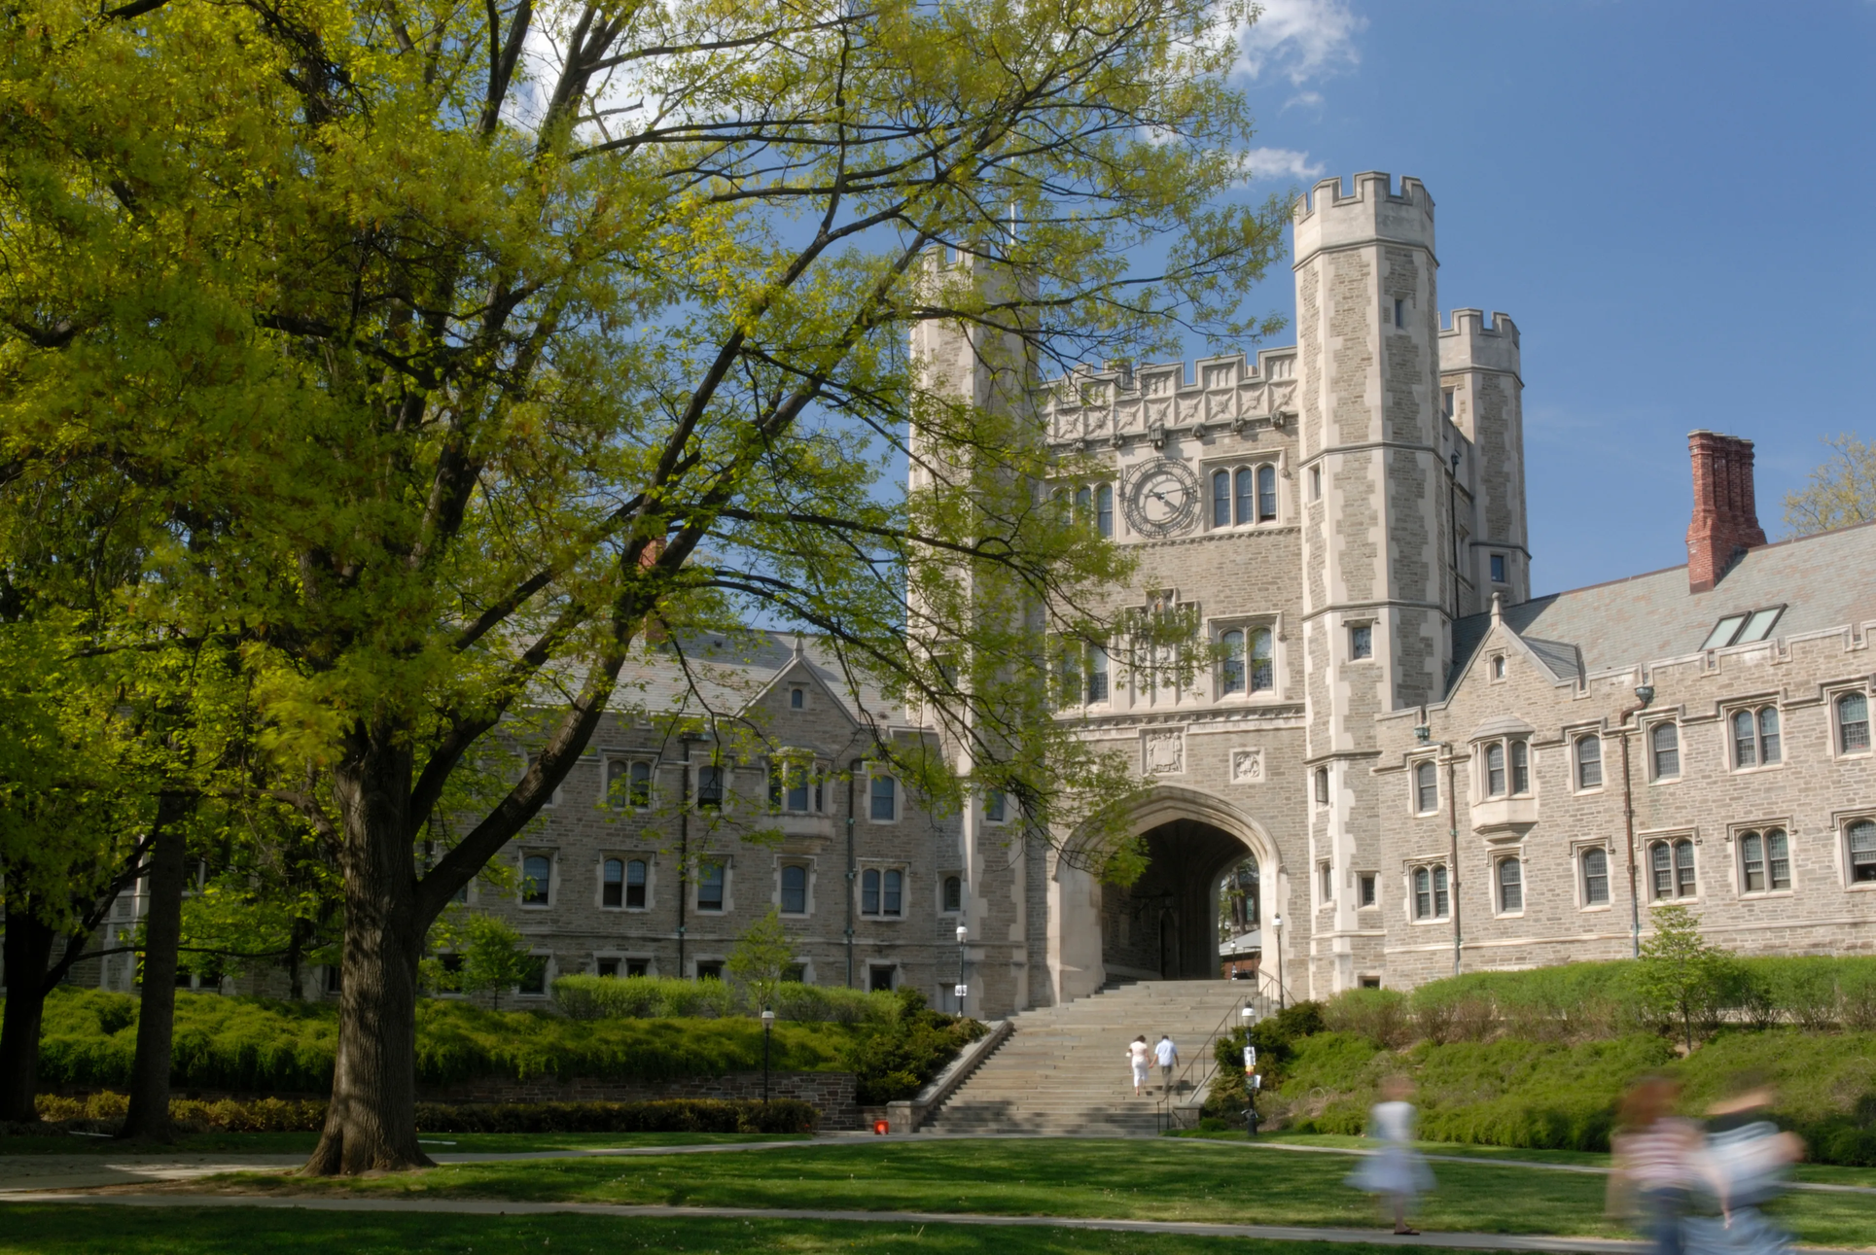


PREDICTING STUDENT'S ACADEMIC SUCCESS
A124 GROUP 8
DSAI MINI PROJECT
NTU

Slide 2

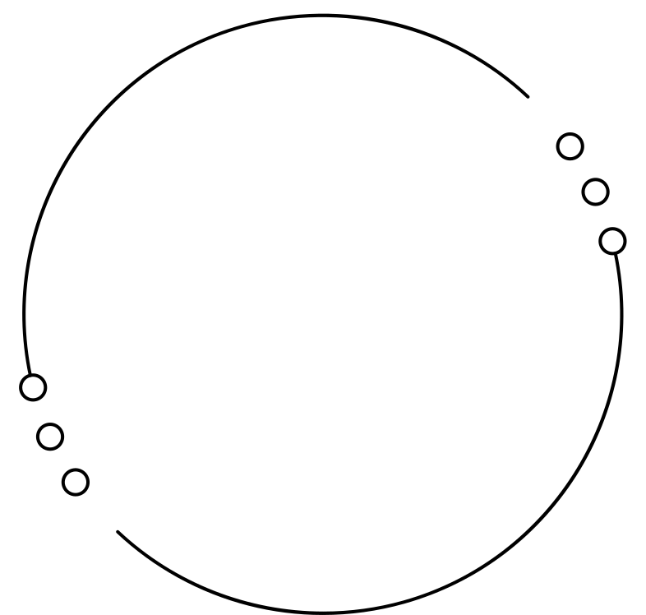
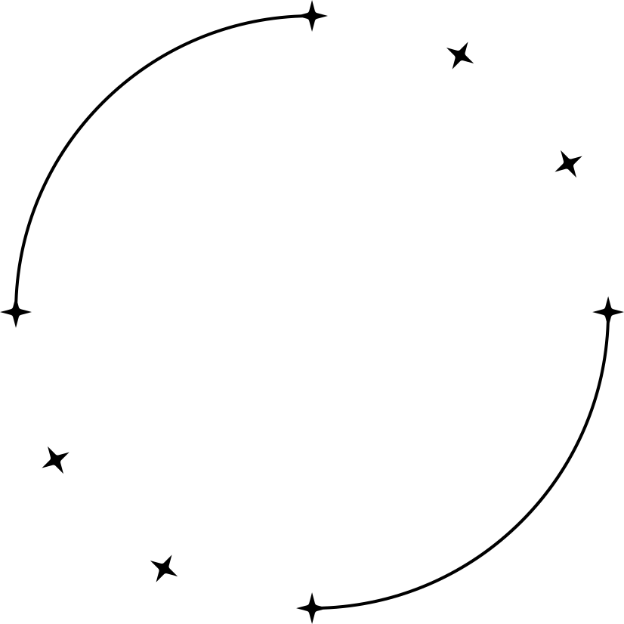
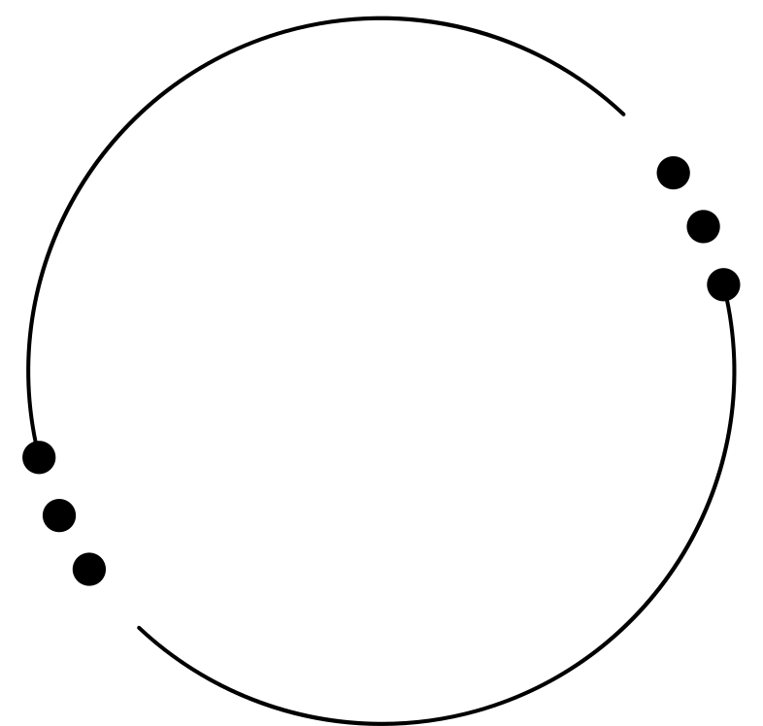



Our Team
Introducing the clowns
Kendrick Koh
Oh ShuYi
Keith Ang
U2222663K
U2220108H
U2220349G

Slide 3


Introduction
In this project, we discuss the main factors that determine a students success in studies using the dataset of Student Performance from the University of Minho
We explore the dataset using various models and numerous algorithms to predict a students grades
University of Minho

Slide 4
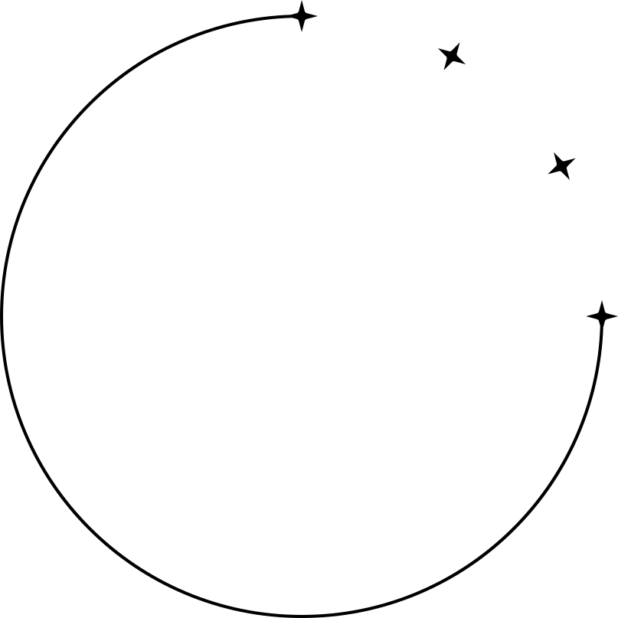



Problem Definition
Inspiration
Coming into NTU, we were exposed to a diverse group of students with unique lifestyles and backgrounds. This made us question if these factors have a significant impact on academic performance, leading us to delve deeper into this subject
Variables*
Parent's education levels
Travel time
Romantic relationship
*List is non-exahustive
Alcohol consumption
Failures in class
Absences from class
How does lifestyle affects students' grades?

Slide 5
Variables of our dataset
# Attributes for both student-mat.csv (Math course) and student-por.csv (Portuguese language course) datasets:
1 school - student's school (binary: "GP" - Gabriel Pereira or "MS" - Mousinho da Silveira)
2 sex - student's sex (binary: "F" - female or "M" - male)
3 age - student's age (numeric: from 15 to 22)
4 address - student's home address type (binary: "U" - urban or "R" - rural)
5 famsize - family size (binary: "LE3" - less or equal to 3 or "GT3" - greater than 3)
6 Pstatus - parent's cohabitation status (binary: "T" - living together or "A" - apart)
7 Medu - mother's education (numeric: 0 - none, 1 - primary education (4th grade), 2 – 5th to 9th grade, 3 – secondary education or 4 – higher education)
8 Fedu - father's education (numeric: 0 - none, 1 - primary education (4th grade), 2 – 5th to 9th grade, 3 – secondary education or 4 – higher education)
9 Mjob - mother's job (nominal: "teacher", "health" care related, civil "services" (e.g. administrative or police), "at_home" or "other")
10 Fjob - father's job (nominal: "teacher", "health" care related, civil "services" (e.g. administrative or police), "at_home" or "other")
11 reason - reason to choose this school (nominal: close to "home", school "reputation", "course" preference or "other")
12 guardian - student's guardian (nominal: "mother", "father" or "other")
13 traveltime - home to school travel time (numeric: 1 - <15 min., 2 - 15 to 30 min., 3 - 30 min. to 1 hour, or 4 - >1 hour)
14 studytime - weekly study time (numeric: 1 - <2 hours, 2 - 2 to 5 hours, 3 - 5 to 10 hours, or 4 - >10 hours)
15 failures - number of past class failures (numeric: n if 1<=n<3, else 4)
16 schoolsup - extra educational support (binary: yes or no)
17 famsup - family educational support (binary: yes or no)
18 paid - extra paid classes within the course subject (Math or Portuguese) (binary: yes or no)
19 activities - extra-curricular activities (binary: yes or no)
20 nursery - attended nursery school (binary: yes or no)
21 higher - wants to take higher education (binary: yes or no)
22 internet - Internet access at home (binary: yes or no)
23 romantic - with a romantic relationship (binary: yes or no)
24 famrel - quality of family relationships (numeric: from 1 - very bad to 5 - excellent)
25 freetime - free time after school (numeric: from 1 - very low to 5 - very high)
26 goout - going out with friends (numeric: from 1 - very low to 5 - very high)
27 Dalc - workday alcohol consumption (numeric: from 1 - very low to 5 - very high)
28 Walc - weekend alcohol consumption (numeric: from 1 - very low to 5 - very high)
29 health - current health status (numeric: from 1 - very bad to 5 - very good)
30 absences - number of school absences (numeric: from 0 to 93)
# these grades are related with the course subject, Math or Portuguese:
31 G1 - first period grade (numeric: from 0 to 20)
32 G2 - second period grade (numeric: from 0 to 20)
33 G3 - final grade (numeric: from 0 to 20, output target)

Slide 6
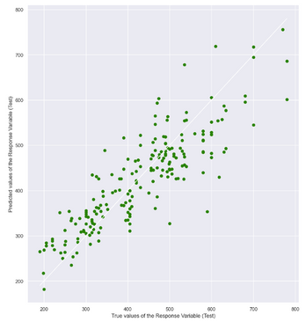
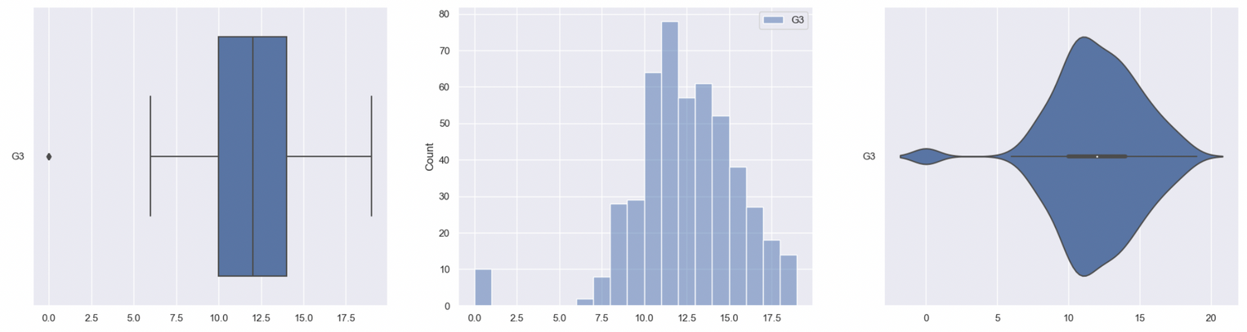
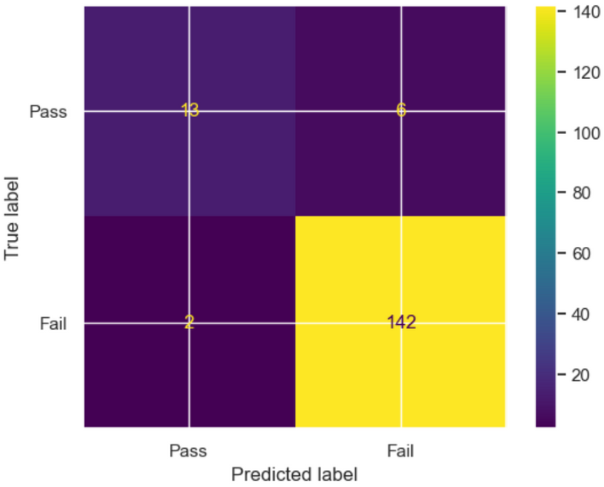
Analysis
How does lifestyle affects students' grades?
Models & Algorithms
Confusion Matrix
Decision Tree
Boxplot
Violinplot
Scatterplot
Algorithms:
Comparison Models:
Catplot
Histogram
Heatmap
Pairplot
One hot encoding*
Elbow Plot*
Cross Validation*
Standard Scalar*
Linear regression
Classification Tree
K-means clustering*
XGBoost (Decision Tree)*
Neural Network*
* Out of Classroom Concepts

Slide 7




SC1015 PROJECT
COVER
INTRODUCTION
CONTENTS
7
TABLE OF
01. EXPLORATORY DATA
ANALYSIS
Contents

Slide 8
SC1015 PROJECT
COVER
INTRODUCTION
CONTENTS
7
TABLE OF
01. EXPLORATORY DATA
ANALYSIS
Contents
02. K-MEANS CLUSTERING

Slide 9
SC1015 PROJECT
COVER
INTRODUCTION
CONTENTS
7
TABLE OF
01. EXPLORATORY DATA
ANALYSIS
Contents
02. K-MEANS CLUSTERING
03. XGBOOST

Slide 10
SC1015 PROJECT
COVER
INTRODUCTION
CONTENTS
7
TABLE OF
01. EXPLORATORY DATA
ANALYSIS
Contents
02. K-MEANS CLUSTERING
03. XGBOOST
04. NEURAL NETWOK

Slide 11
SC1015 PROJECT
COVER
INTRODUCTION
CONTENTS
7
TABLE OF
01. EXPLORATORY DATA
ANALYSIS
Contents
02. K-MEANS CLUSTERING
03. XGBOOST
04. NEURAL NETWOK
05. CONCLUSION

Slide 12
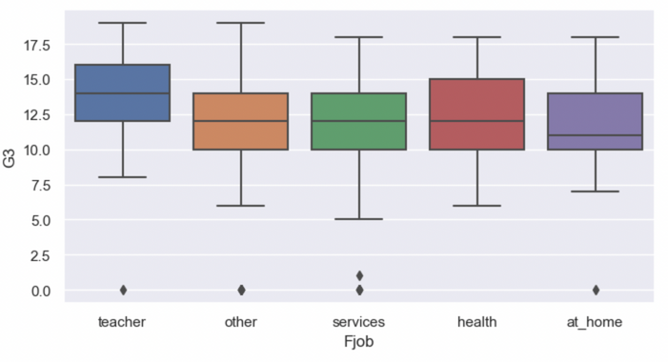
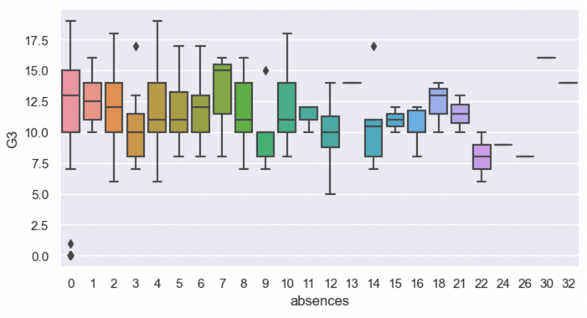
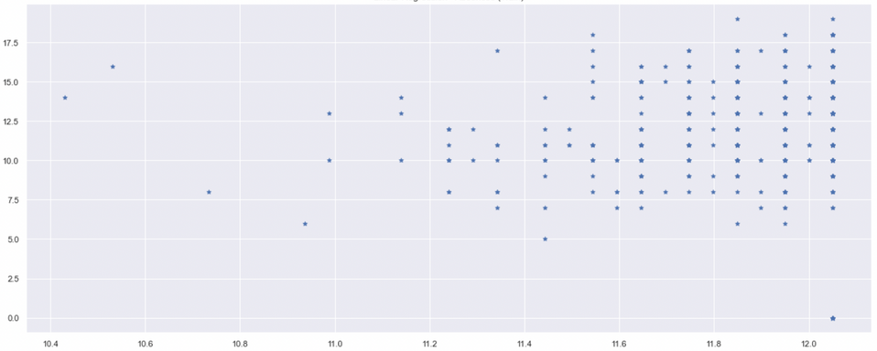
Exploratory Data Analysis
Boxplot and Scatterplot
Shortlisted Data from Dataset:
 | age | Medu | Fedu | travel time | study time | failures | famrel | freetime | goout | Dalc | Walc | health | absences | G1 | G2 | G3
count | 649 | 649 | 649 | 649 | 649 | 649 | 649 | 649 | 649 | 649 | 649 | 649 | 649 | 649 | 649 | 649
mean | 16.744 | 2.5146 | 2.3066 | 1.5685 | 1.9306 | 0.2218 | 3.9306 | 3.1802 | 3.1849 | 1.5023 | 2.2804 | 3.5362 | 3.6594 | 11.3990 | 11.5701 | 11.9060
std | 1.2181 | 1.1345 | 1.0999 | 0.7486 | 0.8295 | 0.5932 | 0.9557 | 1.0510 | 1.1757 | 0.9248 | 1.2843 | 1.4462 | 4.6407 | 2.7452 | 2.9136 | 3.2306
min | 15.00 | 0.00 | 0.00 | 1.00 | 1.00 | 0.00 | 1.00 | 1.00 | 1.00 | 1.00 | 1.00 | 1.00 | 0.00 | 0.00 | 0.00 | 0.00
25% | 16.00 | 2.00 | 1.00 | 1.00 | 1.00 | 0.00 | 4.00 | 3.00 | 2.00 | 1.00 | 1.00 | 2.00 | 0.00 | 10.00 | 10.00 | 10.00
50% | 17.00 | 2.00 | 2.00 | 1.00 | 2.00 | 0.00 | 4.00 | 3.00 | 3.00 | 1.00 | 2.00 | 4.00 | 2.00 | 11.00 | 11.00 | 12.00
75% | 18.00 | 4.00 | 3.00 | 2.00 | 2.00 | 0.00 | 5.00 | 4.00 | 4.00 | 2.00 | 3.00 | 5.00 | 6.00 | 13.00 | 13.00 | 14.00
max | 22.00 | 4.00 | 4.00 | 4.00 | 4.00 | 3.00 | 5.00 | 5.00 | 5.00 | 5.00 | 5.00 | 5.00 | 32.00 | 19.00 | 19.00 | 19.00
We used both Boxplots and Scatterplots to represent the key statistics of the data set:
Notes:
In our Exploratory Data Analysis, we firstly used a boxplot and scatterplot to visualize our data to see the spread of the data.

Slide 13
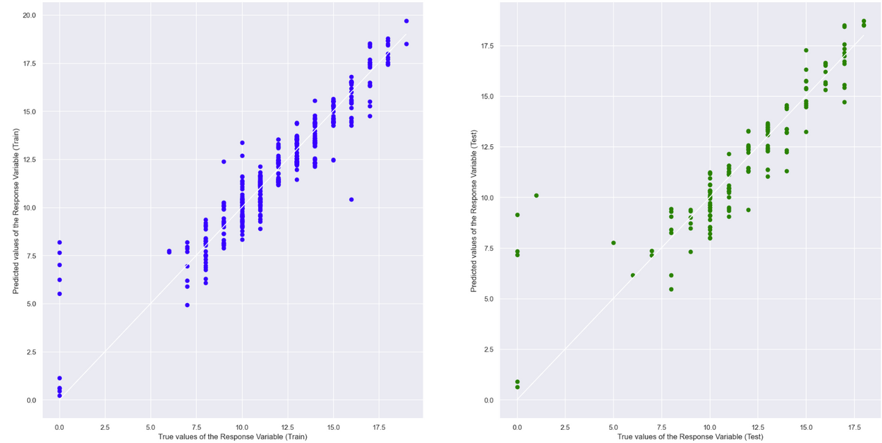
Exploratory Data Analysis
Multi-Variate
Using Linear Regression on our Numeric variables to find out how well does the NUMERIC data perform in predicting G3.
Train Dataset | Train Dataset
R^2 | 0.8766396852939977
MSE | 1.2126869000306661
Test Dataset | Test Dataset
R^2 | 0.7871700007140835
MSE | 2.5819645711104577
Strong positive correlation with G3
Mean Squared Error is quite high of 1.21(train) and 2.58(test)
Notes:
In the next approach to EDA, we tried to find a relationship between all the variables and the grade, G3, using a linear regression model. As you can see from the graph, there is a positive relationship between all the variables with G3 in both our train and test set. The goodness of fit of the variables came up with a R^2 value of approx. 0.88 for train and 0.79 for test set. The mean squared error of train set was 1.21 and 2.58 for the test set. But can we further reduce this mean squared error and increase R^2 value by looking at how each variable varies with G3? Lets find out by looking at the next slide.

Slide 14
Exploratory Data Analysis
Single-Variate
Using the variables as Single-Variate with G3 in the Linear Regression model, we can find out which of the variables are better in predicting G3.
Age:
G1:
Train Dataset | Train Dataset
R^2 | 0.01224741113392136
MSE | 10.573347061569088
Test Dataset | Test Dataset
R^2 | -0.02863569987853
MSE | 9.167635776700525
Train Dataset | Train Dataset
R^2 | 0.6910645214351293
MSE | 3.233387601189883
Test Dataset | Test Dataset
R^2 | 0.6904135480876727
MSE | 3.5113399670185923
Absences:
G2:
Train Dataset | Train Dataset
R^2 | 0.01273899163401837
MSE | 9.991217165800892
Test Dataset | Test Dataset
R^2 | 0.0046835745911092
MSE | 11.286516530937327
Train Dataset | Train Dataset
R^2 | 0.847825219356183
MSE | 1.501946066006123
Test Dataset | Test Dataset
R^2 | 0.845254642736064
MSE | 1.9873237110193824
By looking at the R^2 and MSE of each variable, G2 would be the best variable, followed by G1, absences and age in that order.
Notes:
In this linear regression, we compared G3 with each variable to try to see if any one of the variables would have lower MSE and higher R^2 value, to find out the best variable that is linearly related with G3.
After running the variables through the model, we could see that G2 gave the best relationship with G3 as it can be seen that it has the best R^2 value of 0.85 and lowest MSE of 1.5
However, by comparing these results with the multi-variate analysis, we can see that multi-variate analysis has better R^2 value and lower MSE.
Therefore, in predicting the grades of the students we should a multi-variate approach instead
For the other variables: 'travel time', 'study time', 'failures', we will use a boxplot to see how well they are related to 'G3' as they are categorized from 1 to 4.

Slide 15
Exploratory Data Analysis
Classification Tree
Using classification tree, we evaluate the best predictors for the categorical variables in the dataset. We list the top 4 variables for predicting G3:
1.Extra Educational Support
2.Home Type (Urban VS Rural)
3.Additional Paid Classes
4.Attended Nursery School
Accuracy | 0.867052031213873 | 0.867052031213873 | 0.867052031213873
Accuracy | 0.851637764932562 | 0.851637764932562 | 0.851637764932562
Accuracy | 0.855491329479768 | 0.855491329479768 | 0.855491329479768
Accuracy | 0.855491329479768 | 0.855491329479768 | 0.855491329479768
TPR | 1.0 | FPR | 0.0
TNR | 0.0 | FNR | 1.0
TPR | 1.0 | FPR | 0.0
TNR | 0.0 | FNR | 1.0
TPR | 1.0 | FPR | 0.0
TNR | 0.0 | FNR | 1.0
TPR | 1.0 | FPR | 0.0
TNR | 0.0 | FNR | 1.0
True negative rate and False negative rate is 1.0 for all categorical variables
Not a desirable value for prediction.
Focus on the accuracy of each variable as a means to predict G3 instead.

Slide 16
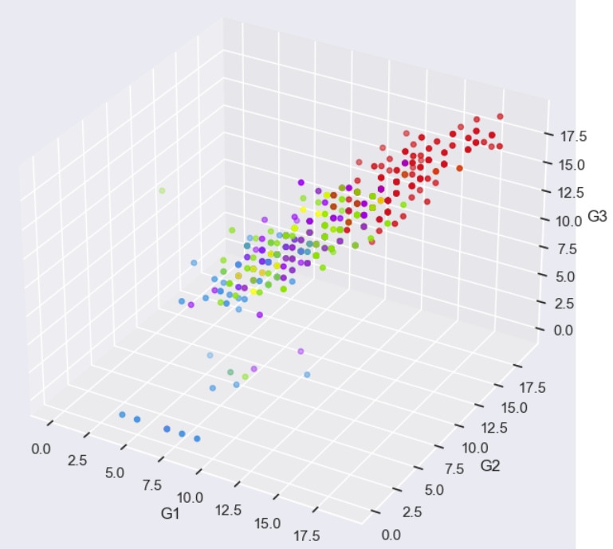
K-Means Clustering
Introduction to K-means
K-means Clustering seeks to divide the number of observations (n) into the number of clusters (k), where each observation belongs to the cluster with the closest mean.
We can analyze the clusters that can be found to affect a student's grades.
Notes:
In using K-means clustering, we are able to divide the number of observations into different unique clusters, then we can study the different clusters to find out if there is a trend in the variables clustered together.
We will also do scaling using a standard scalar to ensure that the clustering algorithm is not biased, meaning we can get a better result in the elbow plot to find out the optimal number of clusters by observing the gradient of the elbow plot.

Slide 17
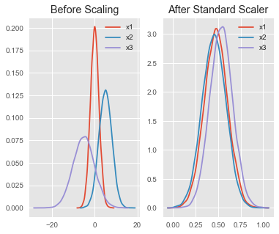
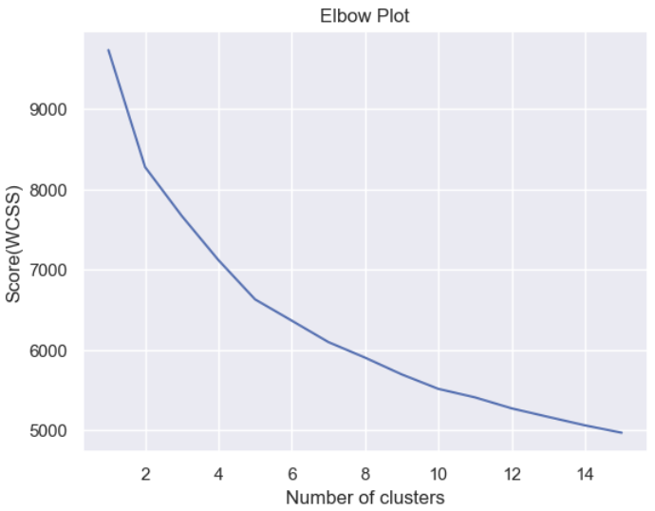
K-Means Clustering
Introduction to K-means
Standard Scalar
A technique in ensuring that the clustering algorithm is not biased towards certain features, and in facilitating a meaningful comparison of WCSS values for different numbers of clusters.
Elbow Plot
To find out the optimal number of clusters by observing the gradient of the curve.
*For illustration purposes only, not the actual graph produced
Notes:
In using K-means clustering, we are able to divide the number of observations into different unique clusters, then we can study the different clusters to find out if there is a trend in the variables clustered together.
We will also do scaling using a standard scalar to ensure that the clustering algorithm is not biased, meaning we can get a better result in the elbow plot to find out the optimal number of clusters by observing the gradient of the elbow plot.

Slide 18

K-Means Clustering
Standard Scalar & Elbow Plot
Used Standard Scalar to remove any biasness before elbow plot
Slope is more gentle -> information gain becomes constant and we choose optimal number of clusters (n) before this happens, where n = 5.
Notes:
After getting rid of any biasness, we can see that when number of clusters is at 5, the gradient there starts to become gentler, which indicates that the information gain is becoming constant and we should choose this value of 5 before information gain reaches a constant value

Slide 19
K-Means Clustering
Clustering
Count | Count
Red | 212
Green | 204
Blue | 127
Yellow | 67
Purple | 39
Highest mean score of G1 to G3: Red cluster
Highest mean score of G1 to G3: Blue cluster
Green, Yellow and Purple have relatively the same mean score throughout G1 to G3
Notes:
Then, we can apply the clustering method to find out how the clusters are formed and how it is spread out.
As seen from the scatterplot, we can see that the red cluster of 212 points has the highest scores throughout G1 to G3 and the blue cluster of 127 points has the lowest scores.
As such, we can now study both of these clusters red and blue to see how the data within the cluster is spread out. By analyzing the variables within these clusters, we can find out which variable is likely to affect the grade of a student.

Slide 20
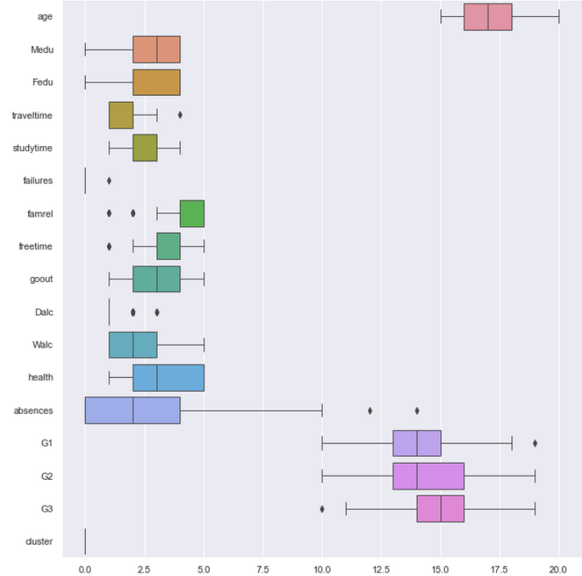
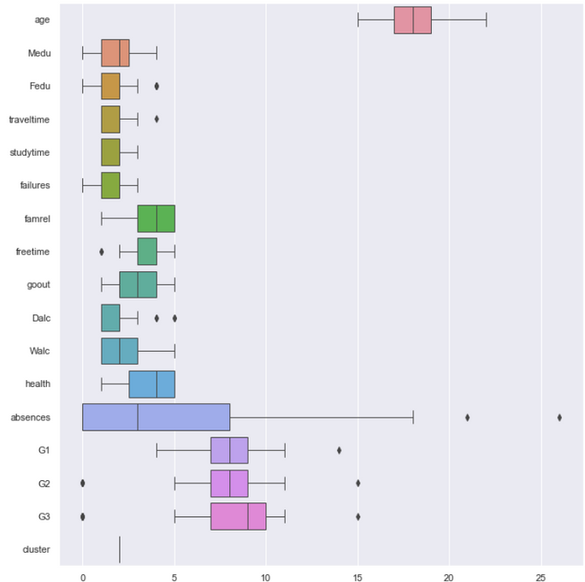
K-Means Clustering
Clustering
Red Cluster
Blue Cluster
Students with better grades have the following attributes:
1) Young
2) Parents having higher education level
3) Shorter home to school travel time
4) Longer weekly study time
5) Less number of class failures
6) Better quality of family relationships
7) More free time after school
8) Hang out with friends more
9) Lower levels of alcohol consumption on both workdays and weekends
10) LOWER health levels
11) Lower numbers of school absences
Notes:
By looking at the boxplot of the red cluster with the highest mean grade and blue cluster with lowest mean grade, we can see the attributes that students with better grades possess.
Using the mean as the benchmark, we can see the following attributes in students with better grades:
1) Young
2) Parents having higher education level
3) Shorter home to school travel time
4) Longer weekly study time
5) Less number of class failures
6) Better quality of family relationships
7) More free time after school
8) Hang out with friends more
9) Lower levels of alcohol consumption on both workdays and weekends
10) LOWER health levels
11) Lower numbers of school absences

Slide 21
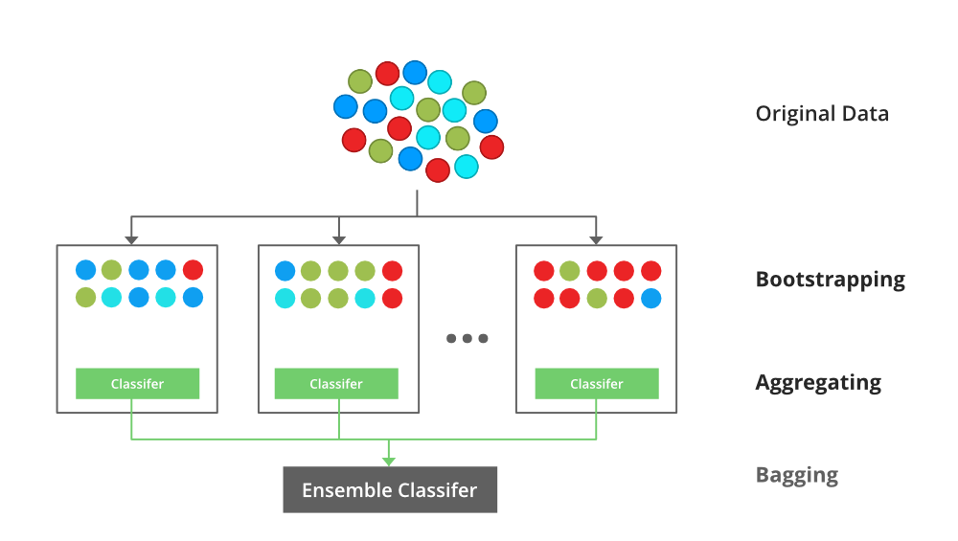
XGBoost
eXtreme Gradient Boosting
XGBoost (eXtreme Gradient Boosting) is a popular and powerful open-source machine learning library that utilizes gradient boosting to enhance predictive models' accuracy and speed.
In our project, we use XGBoost to predict G3 using all variables and selected k-means variables

Slide 22
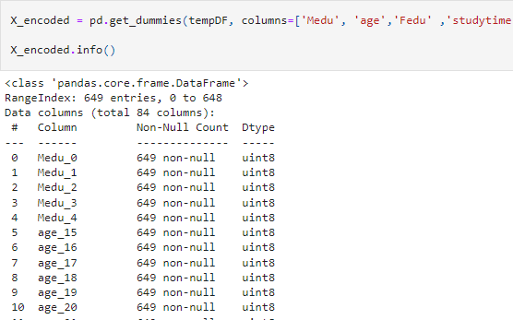
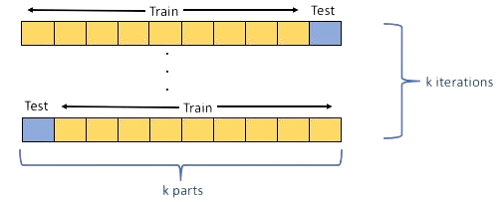
XGBoost
eXtreme Gradient Boosting
One Hot-Encoding
A technique in data encoding that converts categorical variables into a binary format
Cross-Validation
Assesses and tunes the model's hyperparameters, avoid overfitting and estimate its performance on unseen data

Slide 23
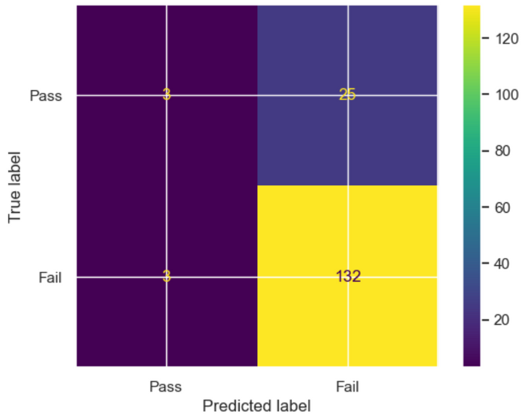
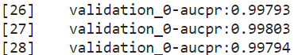
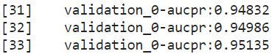
XGBoost Results
eXtreme Gradient Boosting
All Variables
K-means variables
Accuracy | 0.951 | 0.951 | 0.951
Accuracy | 0.828 | 0.828 | 0.828

Slide 24
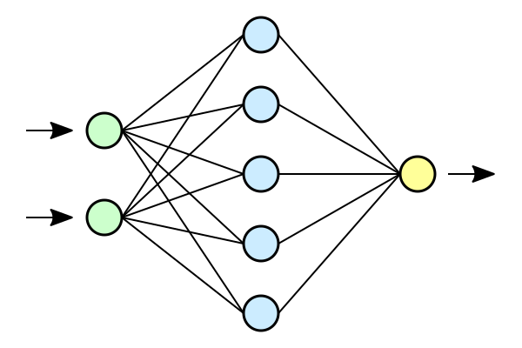
Artificial Neural Network
Linear Regression
Artificial neural networks are one of the deep learning algorithms designed to recognise patterns and learn from data, simulating the workings of the neurons in the human brain.
In our project, we use Neural Network for:
Improving the MSE values of the variables from the linear regression model.
Checking if the shortlisted variables by K-means clustering has a better linear regression model (after improvements)

Slide 25
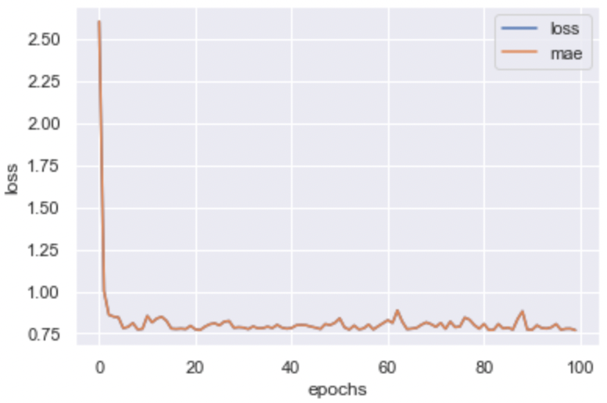
Artificial Neural Network
Linear Regression
Tensorflow libraries were used to construct the neural network model.
Model Specifications: 100 epochs; Adam optimiser; MAE evaluation metrics
A Loss Curve was plotted after every training and fitting of the different models to ensure that there was an improvement to the MAE value through the training

Slide 26
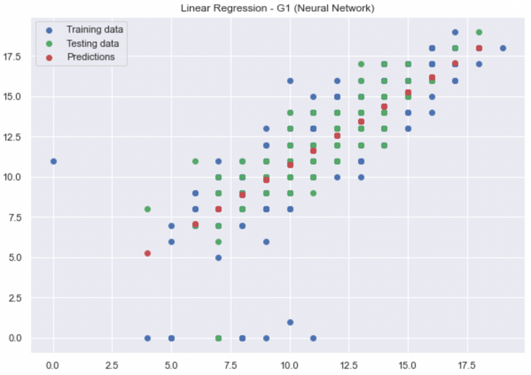
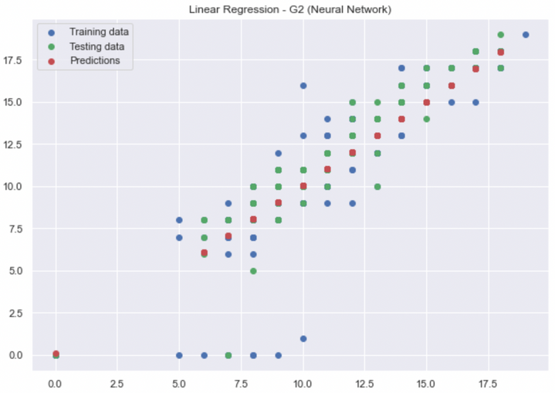
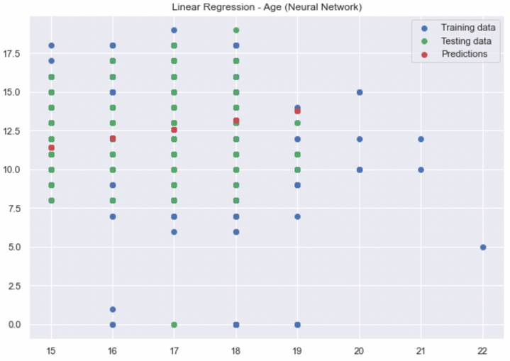
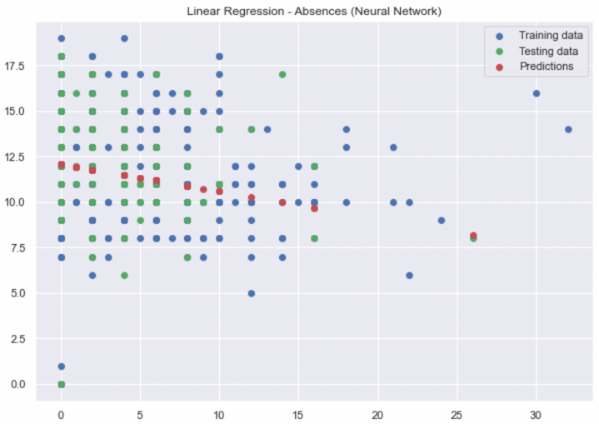
Artificial Neural Network
Comparison
By looking at the MAE and MSE of each variable, order of variable importance:
G2
G1
Age
Absences
Similar as the results from the single-variate linear regression model.

Slide 27
Artificial Neural Network
K-Means vs All Numerical
% Decrease in MSE | % Decrease in MSE
G1 | 17.69%
G2 | 27.80%
Age | 7.26%
Absences | 8.78%
Neural Network - Test Dataset MSE | Neural Network - Test Dataset MSE
G1 | 2.8900163
G2 | 1.4348648
Age | 8.50226
Absences | 10.295562
In general, there is also an improvement to the MSE value from the neural network as compared to the linear regression model values.
K-means clustering shortlisted variables not as important to predict G3 as compared to the other numerical variables.
Order of importance from K-means clustering for the shortlisted variables is the same as the results from the Neural Network model

Slide 28
Data Analysis
K-Means Clustering vs Raw Dataset
Using all variables generally results in higher accuracy and prediction scores
 | age | Medu | Fedu | travel time | study time | failures | famrel | freetime | goout
count | 649 | 649 | 649 | 649 | 649 | 649 | 649 | 649 | 649
mean | 16.744 | 2.5146 | 2.3066 | 1.5685 | 1.9306 | 0.2218 | 3.9306 | 3.1802 | 3.1849
std | 1.2181 | 1.1345 | 1.0999 | 0.7486 | 0.8295 | 0.5932 | 0.9557 | 1.0510 | 1.1757
min | 15.00 | 0.00 | 0.00 | 1.00 | 1.00 | 0.00 | 1.00 | 1.00 | 1.00
25% | 16.00 | 2.00 | 1.00 | 1.00 | 1.00 | 0.00 | 4.00 | 3.00 | 2.00
50% | 17.00 | 2.00 | 2.00 | 1.00 | 2.00 | 0.00 | 4.00 | 3.00 | 3.00
75% | 18.00 | 4.00 | 3.00 | 2.00 | 2.00 | 0.00 | 5.00 | 4.00 | 4.00
max | 22.00 | 4.00 | 4.00 | 4.00 | 4.00 | 3.00 | 5.00 | 5.00 | 5.00
However, we need to consider that each dataset is different and this result is not applicable to all datasets.

Slide 29
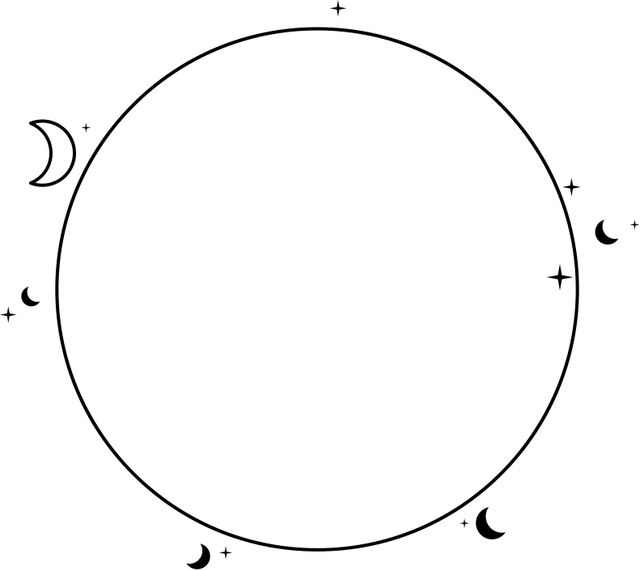



Outcomes
Higher parent's education
Better family relationship
Higher Study time
Impactful Factors

Slide 30



Outcomes
Lower Alcohol consumption
Decrease in absences
Decrease in class failures
Impactful Factors

Slide 31


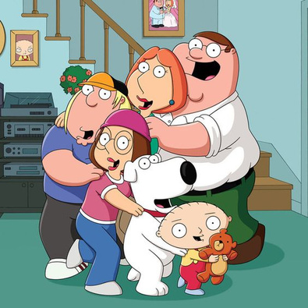
Recommendations
Parents
Promote higher education and a broader educational outlook
Improve family relationships through open communication and increase in quality time spent
Individual
Increase in focused study time
Reduce in absences from school
Strive to achieve passes in tests and assignments
Reduce in alcohol consumption
How to get better grades?

Slide 32
Bye Bye
Thank You

